Slide 1

ECE 515 Project
Lane Detection Methods:
A Comparison Study
Atanas Delevski
Zhaobang Xue

Slide 2

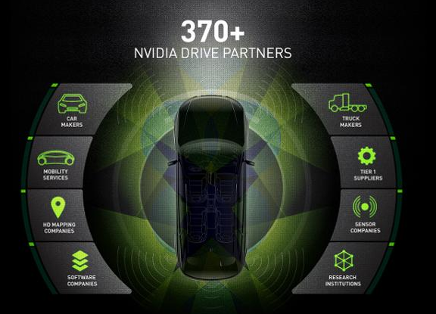
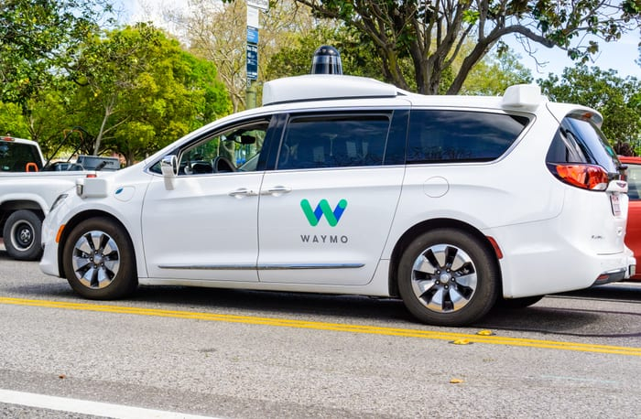
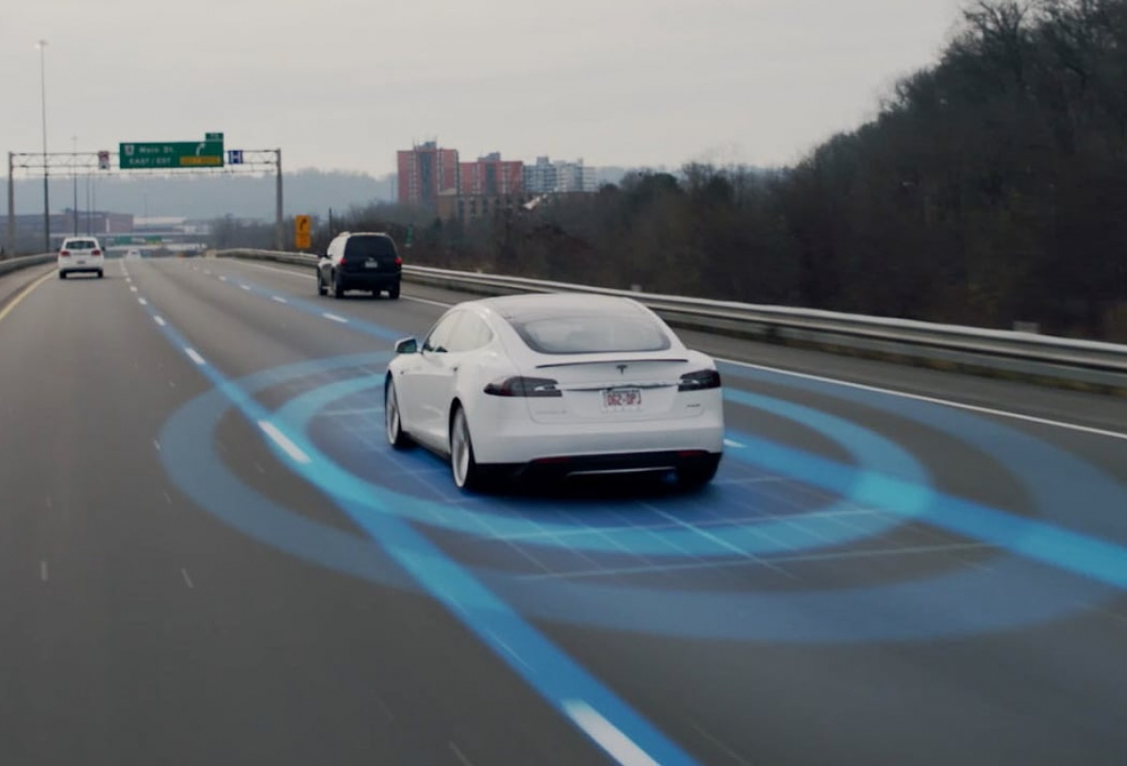
Background
With so many companies working on autonomous vehicles today, we thought it would be interesting to see the different ways in which they all implement lane detection.
We decided to look at the top most popular methods and try to either implement them on our own, or learn about them enough to where we knew the advantages and disadvantages of each method.
https://specials-images.forbesimg.com/imageserve/5b5250daa7ea434a79788cd6/960x0.jpg?fit=scale
https://www.teslamotors.com/sites/default/files/styles/customer_2x_mobile_1200x816/public/media-vimeo/154227644.jpg
https://securecdn.pymnts.com/wp-content/uploads/2019/10/waymo-driverless-cars-autonomous-vehicles-arizona-.jpg

Slide 3
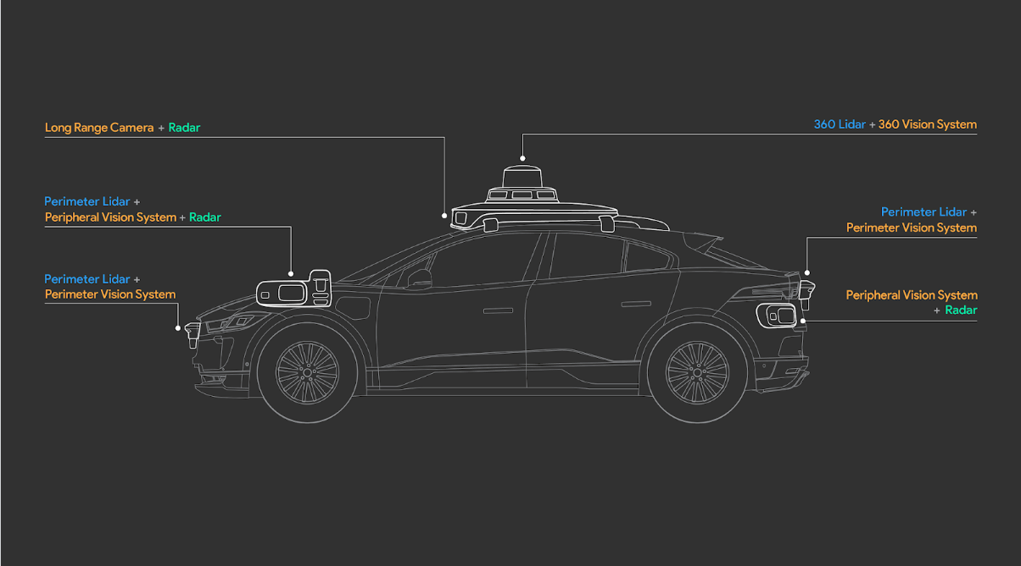
Disclaimer
For the sake of simplicity, we will not talk about general autonomous vehicle approaches and the cutting edge technologies being used by Waymo and Tesla.
They have methods for collective learning where each of their cars record many miles worth of driving and then their networks are trained on the recordings using deep reinforcement learning in the case of Tesla or a modular system in the case of Waymo.
This is impossible to replicate without the necessary infrastructure in place, including having many test cars/drivers/servers/teams for collecting, analyzing, and using all of their data.
Instead, we will focus purely on the computer vision techniques that have been used throughout time for detecting lanes using just a camera input.

Slide 4

Feature Based
01
Model Based
02
Comparisons
03
We will go over the more simple, feature based methods in this section
Here we will discuss the more complicated model based implementations
Finally, we will compare all the different methods that we have discussed

Slide 5

Feature Based
Feature based models use computer vision techniques to capture the lane lines and distinguish them from the rest of the objects in the video.
Most companies out there today are way past this method, but this is how it all began.

Slide 6
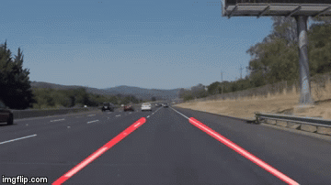
Hough Transform
As we have learned from class, the Hough transform can be used to detect lines in an image/video after edge detection has been established
This method is pretty rudimentary and has many problems
Input
1st - Grayscale
2nd - Gaussian Blur
3rd - Canny Edge Detection
4th - Segment Mask
5th - Hough Transform
Output

Slide 7
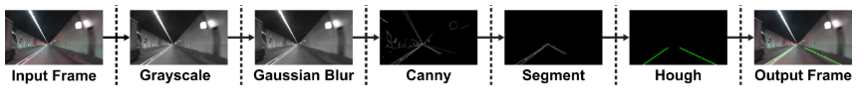
Why is this not the best?
Curvy Roads
Road Markings
Lighting
https://towardsdatascience.com/tutorial-build-a-lane-detector-679fd8953132
Despite the Hough transform working pretty well on straight roads, it immediately has trouble once there is a turn, especially sharp turns.
Any type of road markings other than the lane lines (directional arrows for example) will interfere with the algorithm and confuse it
The Hough transform relies on good lighting in order for it to work. Night time, fog, rain, snow, etc would make it hard for it to work

Slide 8

Our demo of Hough transform

Slide 9
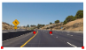
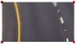
Projective Transform
Gives birds eye view of the lane
This makes it easier to draw the lines, as curves are suppressed
Input
1st - Grayscale
.
.
2nd - Edge Detection
3rd - Projective Transform
4th - Histogram and Mask
5th - Line Fit and Reversal
Output

Slide 10
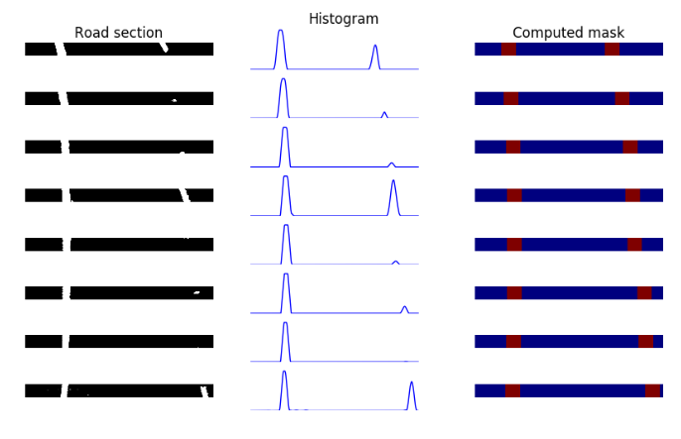
Projective Transform
The first frame is taken and split into 8 sections from top to bottom.
A histogram is taken to count where in the section the lane was
A mask is then made and after this has been repeated for all 8 section, they are put together.
https://chatbotslife.com/robust-lane-finding-using-advanced-computer-vision-techniques-46875bb3c8aa

Slide 11




Reconstruction and Line Fitting
The reconstructed window mask that is used to fit the curve of the lanes using polyfit function
https://chatbotslife.com/robust-lane-finding-using-advanced-computer-vision-techniques-46875bb3c8aa

Slide 12


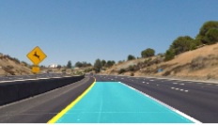
Reversal
https://chatbotslife.com/robust-lane-finding-using-advanced-computer-vision-techniques-46875bb3c8aa

Slide 13
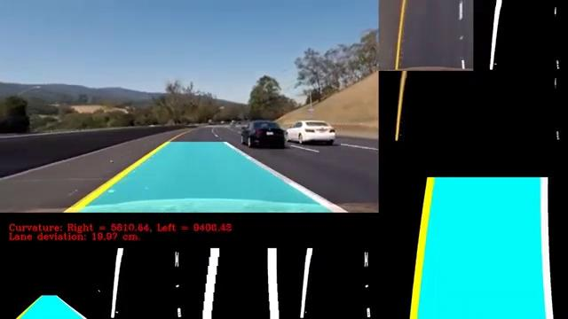
Projective Transform Demo
https://chatbotslife.com/robust-lane-finding-using-advanced-computer-vision-techniques-46875bb3c8aa

Slide 14
Model Based
1st - Categorize the lane as a geometric model
2nd - Fit the lane lines using the models parameters
Usually uses deep learning

Slide 15
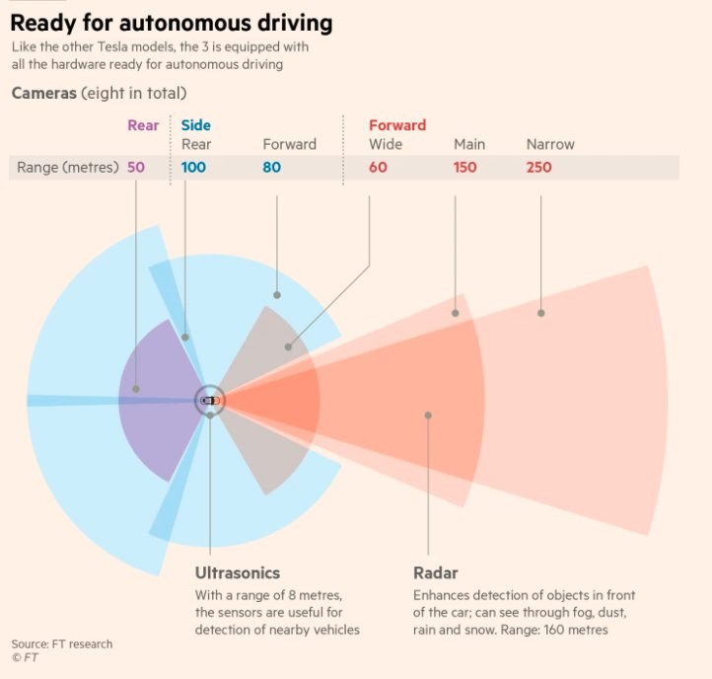
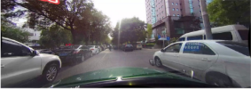
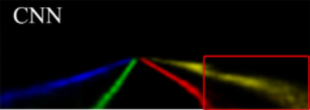
Model Based can mean many different things!
These can range from simple models based entirely on one viewpoint (i.e. one camera)
To very complicated models that include many different cameras, LiDAR, RADAR, etc..
We’re referring to this type of model!

Slide 16
The Model-Based Methods We Will Cover!
Semantic Segmentation
CNN
Spline Model

Slide 17
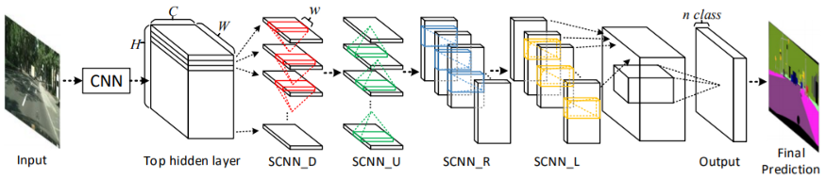
Spatial CNN
A lot more effective than feature-based models like the Hough or the Projective
Builds on top of Conv. Neural Nets
Still not as advanced as the cutting edge
CULane Dataset
SCNN Model
Output

Slide 18
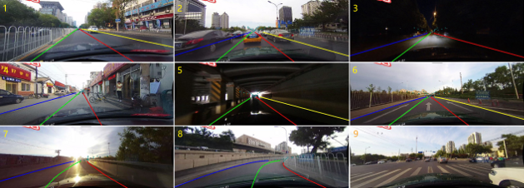
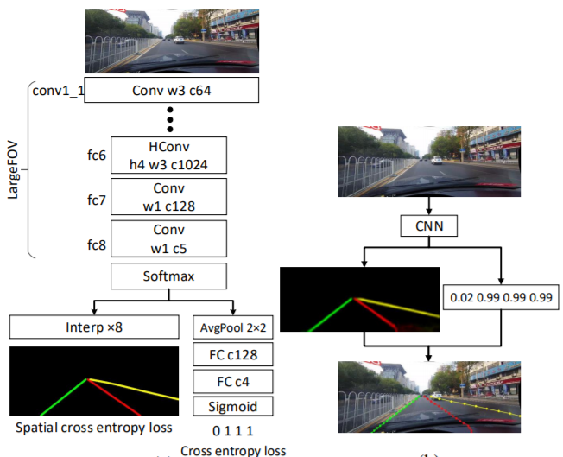
Spatial CNN Explained
First, the CULane Dataset was created with annotated lane lines
Each lane line (blue, green, red, and yellow) is treated as its own class, and the model creates a probability map for each
Finally, a separate network is used to predict the actual lines that will represent the lane lines out from the probability maps

Slide 19
Spatial CNN

Slide 20
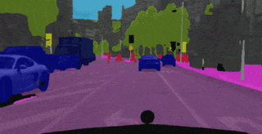
Semantic Segmentation
Widely used computer vision method.
Can be used for object detection and tracking.
It clusters parts of an image together which belong to the same class
Also uses deep learning.
Establishes the road as the ‘ground-truth’

Slide 21
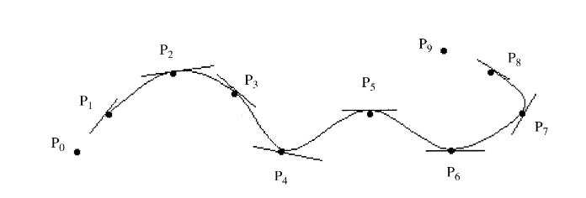
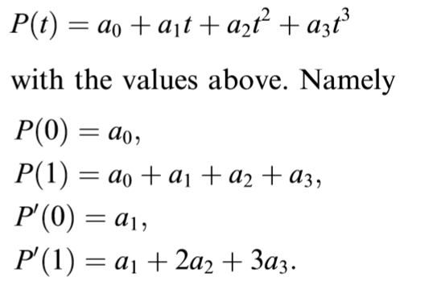
Lane detection using spline model

Slide 22
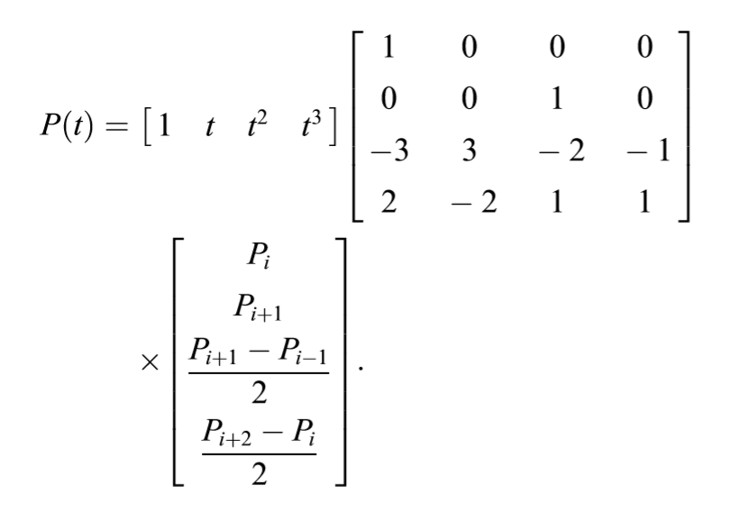
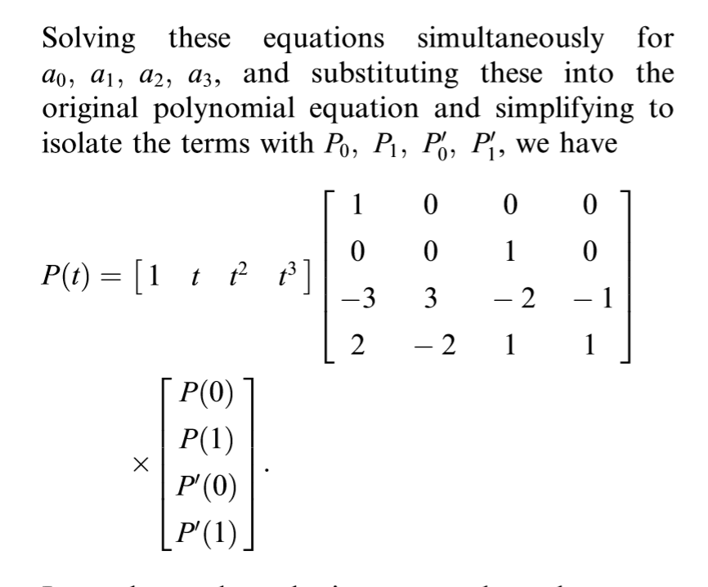
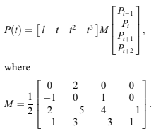
Spline Model Continued

Slide 23
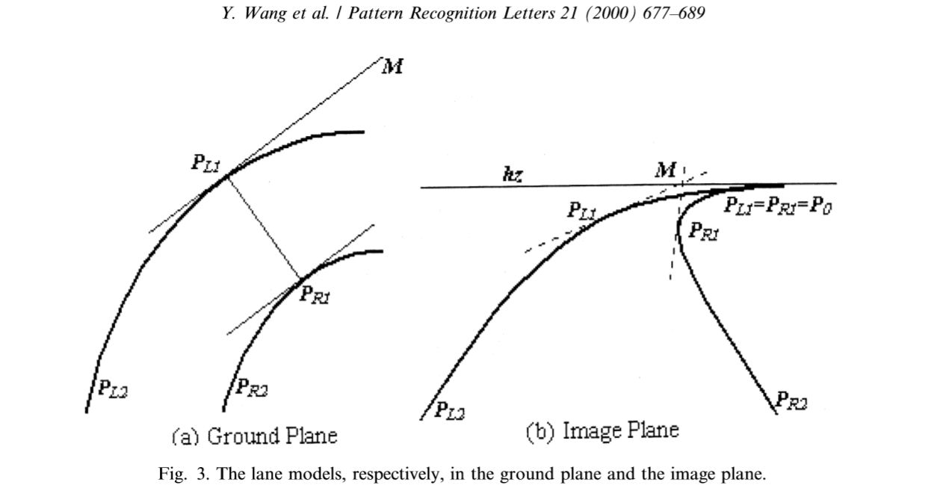
Spline Model
The lane model is based on Catmull-Rom spline and a matching measurement between the model and the real road edges based on maximum likelihood.
It is a local interpolating spline developed for computer graphics purpose. It was initially used to design curves and surfaces in graphics, but recently it has been applied in several other applications.

Slide 24
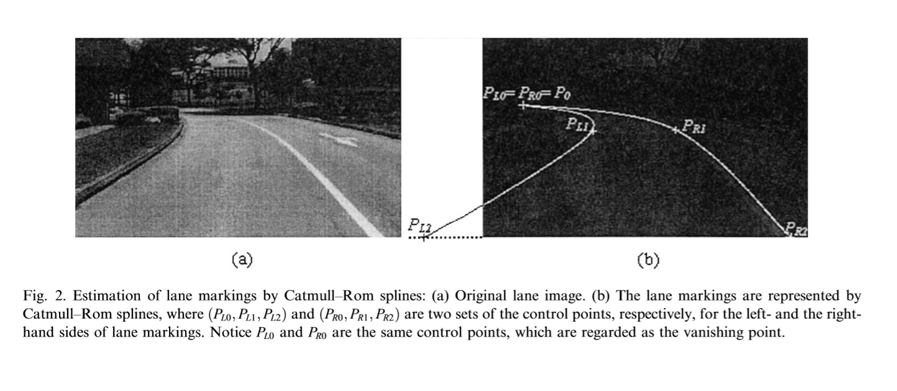
Spline Model Continued
Finding the control points for the left and right line
Eventually, both sides join together for the vanishing point

Slide 25
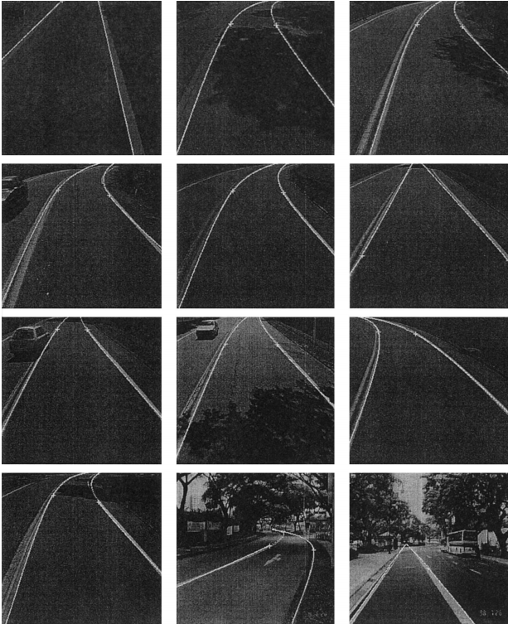
Spline Method Results
As you can see, the spline method is way better at curved roads and sharp turns than previous models.

Slide 26
Comparisons
 | Hough | Projective | Spatial CNN | Semantic | Spline
Pros | Simple and fast | Simple and fast | Robust | Can be used for object detection and tracking as well | Better at turns than the other methods
Cons | Need custom mask, and has trouble with turns, lighting, road markings | Also needs custom work for transform corner points. Has trouble with sharp turns | Needs lots of training data, and not the greatests when it comes to turns | Needs more additional work to establish a lane detector | Does not do well with obstructed lane markings and other road markings
Complexity | 2/10 | 3/10 | 7/10 | 7/10 | 5/10

Slide 27
Resources
https://towardsdatascience.com/tutorial-build-a-lane-detector-679fd8953132
https://chatbotslife.com/robust-lane-finding-using-advanced-computer-vision-techniques-46875bb3c8aa
https://ieeexplore.ieee.org/stamp/stamp.jsp?arnumber=9046805
https://xingangpan.github.io/projects/CULane.html
https://arxiv.org/pdf/1712.06080.pdf
https://towardsdatascience.com/your-guide-to-ai-for-self-driving-cars-in-2020-218289719619
https://blog.waymo.com/2020/03/introducing-5th-generation-waymo-driver.html
https://github.com/murtazahassan/Curved-Lane-Detection
https://www.sciencedirect.com/science/article/pii/S0167865500000210?casa_token=30iz6Yaqdm4AAAAA:N9LsAbzFbrKHbeLmHum98jvHiQFb144ZUI0jaLdnoodd9zMXonpGEmynkuejZYIbRc5dW4gs3g#FIG1
https://link.springer.com/chapter/10.1007/978-3-642-23687-7_5
http://citeseerx.ist.psu.edu/viewdoc/download?doi=10.1.1.353.8182&rep=rep1&type=pdf
https://ieeexplore.ieee.org/abstract/document/1520207
https://www.ncbi.nlm.nih.gov/pmc/articles/PMC6679325/
https://link.springer.com/chapter/10.1007/978-3-662-45286-8_43
https://ieeexplore.ieee.org/abstract/document/6384266
https://ieeexplore.ieee.org/abstract/document/6113579

